Slide 1
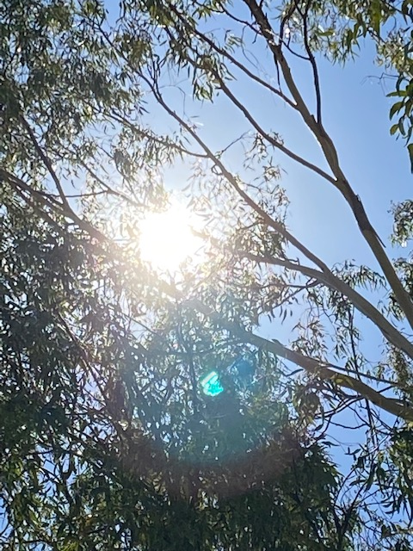
Staff Prayer Catholic Education Week 2022
“Share the Good News”

Slide 2
ACKNOWLEDGEMENT OF COUNTRY:
In recognition of First Nation People's spiritual and cultural connection to country, we acknowledge the traditional custodians of this land.
We acknowledge the continued care of the land and waterways over thousands of generations and celebrate the continuation of a living culture that has a unique role in Australia.
We pay our respects to Elders past, present and emerging for they hold the memories, traditions, culture and hope of First Nations peoples across the nation.
( Adapted from Aboriginal Catholic Ministry Melbourne)

Slide 3
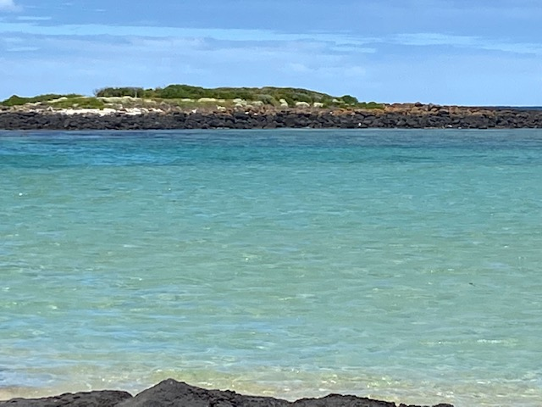
Invitation to prayer……..
Let us be still for a moment.
Become aware, of how you are feeling, what our bodies are telling us.
I invite you to focus on the sacred in your life.

Slide 4
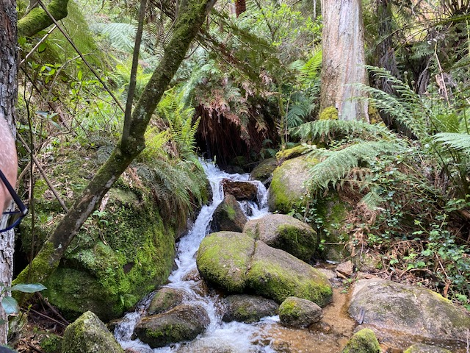
What does it mean for you to “Spread The Good News?”
We begin our prayer by acknowledging the presence of God the Creator. In the name of the Father, and the Son and the Holy Spirit. Amen
Spend some time connecting with your own thoughts and feelings about this title of Catholic Education Week 2022.
You will not be invited to share this with anyone

Slide 5
Spread the Good News
This week we come together to celebrate Catholic Education.
A story of hope and transformation.
At the very heart of what we all do – no matter our roles, is to spread the message of Jesus of Nazareth, Jesus the Christ, the message of Good News to all creation.
We walk in the footsteps of those who have gone before us, since the time of Jesus, in responding to this call.
The “Good News” is being spread daily in the each of our school communities across our diocese – we bring each of these communities to our prayer as we are reminded of the richness of who we are in the following three slides.

Slide 9
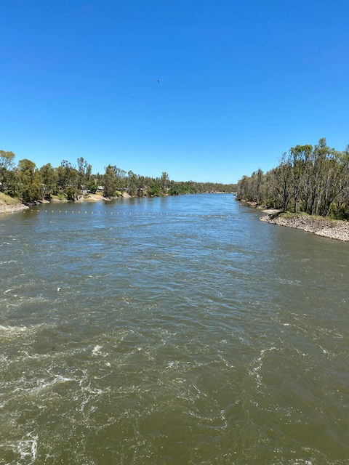
Opening Prayer:
Creator God
We celebrate Catholic Education, this week across The Ballarat Diocese. We give thanks for our communities of hope and transformation that are spread from the Murray to the Sea. We pray that we will be energized with courage and hope to continually spread the Good News. We ask this through Jesus our brother.
Amen

Slide 10
Gospel
Mark 16: 14
And he said to them, “Go into all the world and proclaim the good news to the whole creation.”

Slide 11
Time for reflection…..
What is the “Good News”?
What does it look like?
How are we as a school community People of The Good News?
What can I do to be a bearer AND creator of The Good News?

Slide 12
The Lord’s Prayer – Inviting us to be Good News.
Our Father who art in heaven … you always stand with the weak, the powerless, the poor, the abandoned, the sick, the aged, the very young and those who suffer.
Hallowed by thy name … May the reverence we give your name pull us out of selfishness that prevents us from seeing the pain of our neighbour.
Your kingdom come, your will be done … help us to create a world where, we will act justly, love tenderly, and walk humbly with you and each other.

Slide 13
On earth as in heaven … may the work of our hands, give you glory so that the joy, graciousness, tenderness, and justice of heaven will show forth on earth.
Give us this day our daily bread … so that each person in the world may have enough food, enough clean water, enough clean air, adequate health care, and sufficient access to education so as to have the sustenance for a healthy life. Teach us to give from our sustenance and not just from our surplus.

Slide 14
And forgive us our trespasses … forgive us our blindness towards our neighbour, our obsessive self preoccupation, our racism, our sexism, and our incurable propensity to worry only about ourselves and our own. Forgive us our capacity to watch the evening news and do nothing about it.
As we forgive those who trespass against us … help us to forgive those who victimize us. Help us to mellow out in spirit, to not grow bitter with age, to forgive the imperfect systems that wounded and ignored us.

Slide 15
And do not put us to the test but deliver us from evil … do not judge us only by whether we have fed the hungry, given clothing to the naked, visited the sick, or tried to mend the systems that victimized the poor. Spare us this test for none of us can stand before this gospel scrutiny. Give us, instead, more days to bring your dream for the world into reality.
Amen.
Adapted from Ron Rolheiser

Slide 16
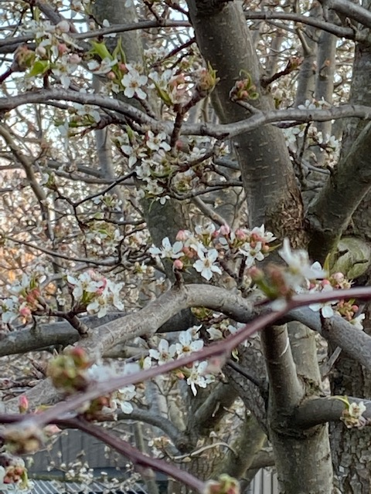
Let us pray…..
Loving God
May we be the Good News, in our words, in our actions, in all that we do. As we go forth may we never forget that you journey with us as we transform all of creation inspired by your love.
We ask this though Christ our Lord.
Amen

Slide 17
A song that might speak to you about spreading The Good News………..

Slide 18
Acknowledgements:
Music: https://www.bensound.com
Ronald Rolheiser – The Lord’s Prayer found at:
http://www.ottawacspa.ca/cspa/images/prayers/Lords%20Prayer%20for%20Justice.pdf
"You Raise Me Up" - cover by COLOR MUSIC Children's Choir found at:
https://www.youtube.com/watch?v=TRcIEMgppK8&list=RDLtKJBX7oHIY&index=8
Photos: Collection of Jim Waight
School logos from across the Ballarat Diocese found at:
https://dobcel.catholic.edu.au/

